Slide 1
House price prediction
Submitted by
Akash

Slide 2
Table of Content
Introduction of project
Data cleaning
Data visualization
Data scaling
Data preprocessing
Model training
Predicting the prices

Slide 3
Introduction
Real estate is the biggest market in the world everyone wants their own houses. It’s the biggest problem to find the exact price of the property or house. Whenever a new company want to comes in the real market or some individual shifted to the new city the want to know the price of the property there. The property price could be vary on many factors like location area garage space parking area, neighbourhood, house facing etc. so because of these many factors the prices changes everytime. So the consumer or the company took the idea of the prices of houses using machine learning.

Slide 4
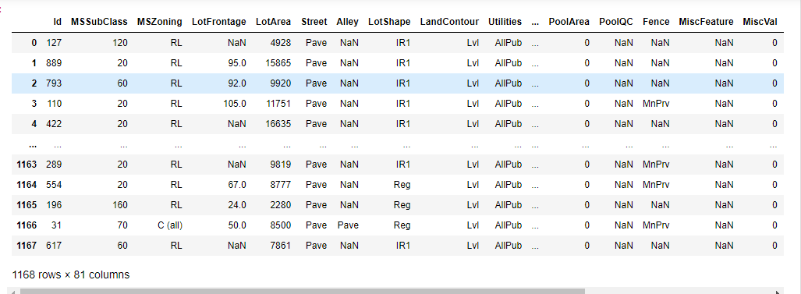
Understanding the model
we are required to model the price of houses with the available independent variables. This model will then be used by the management to understand how exactly the prices vary with the variables. They can accordingly manipulate the strategy of the firm and concentrate on areas that will yield high returns. Further, the model will be a good way for the management to understand the pricing dynamics of a new market.

Slide 5
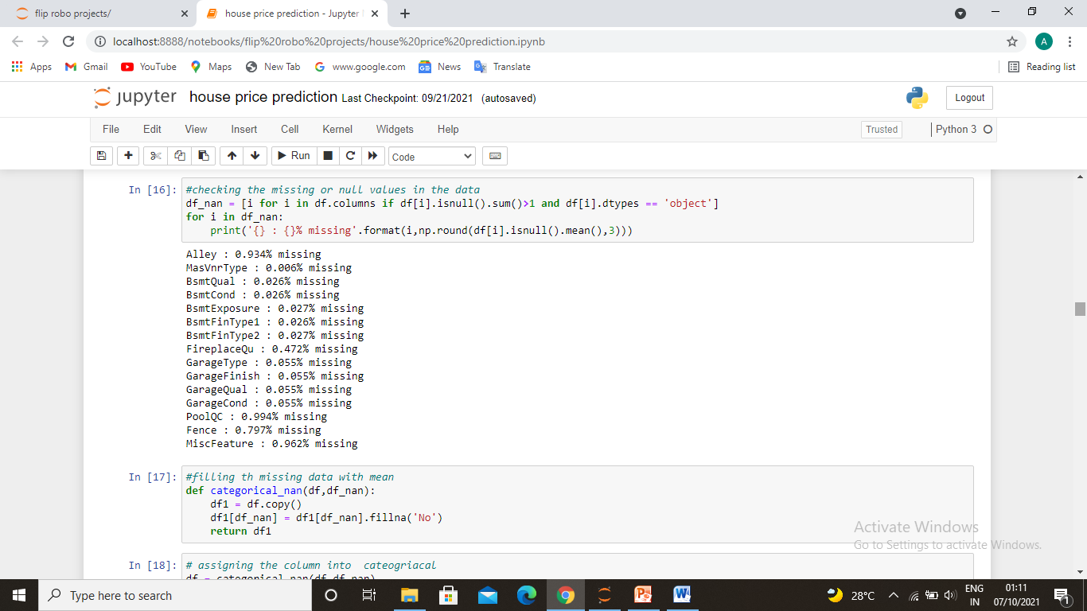
Data cleaning
The mathematical problems are included this was the huge data so getting null values is not a big deal. So there is many null values we need to tackle with them because of huge data there are many rows and columns i.e.80 columns first of all we need to understand all the columns than understand which will work for us to make prediction mode for prices. After these we need to check the data is balanced or not. Checking for outliers adjust them and some other works are accured at the time of making the model. We used random forest regressor to predict the prices and putting them into the test data to predict the prices of the houses.

Slide 6
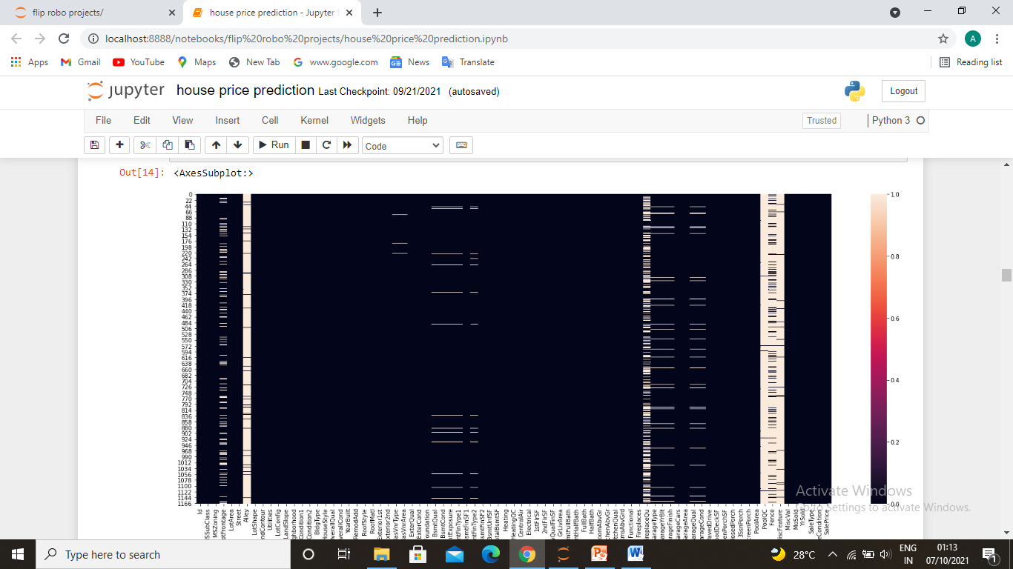
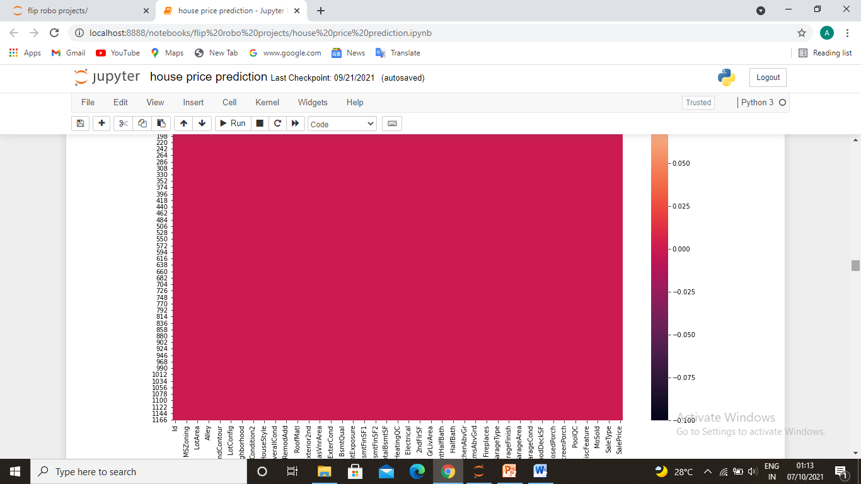
Heat map for null values before and after data cleaning

Slide 7
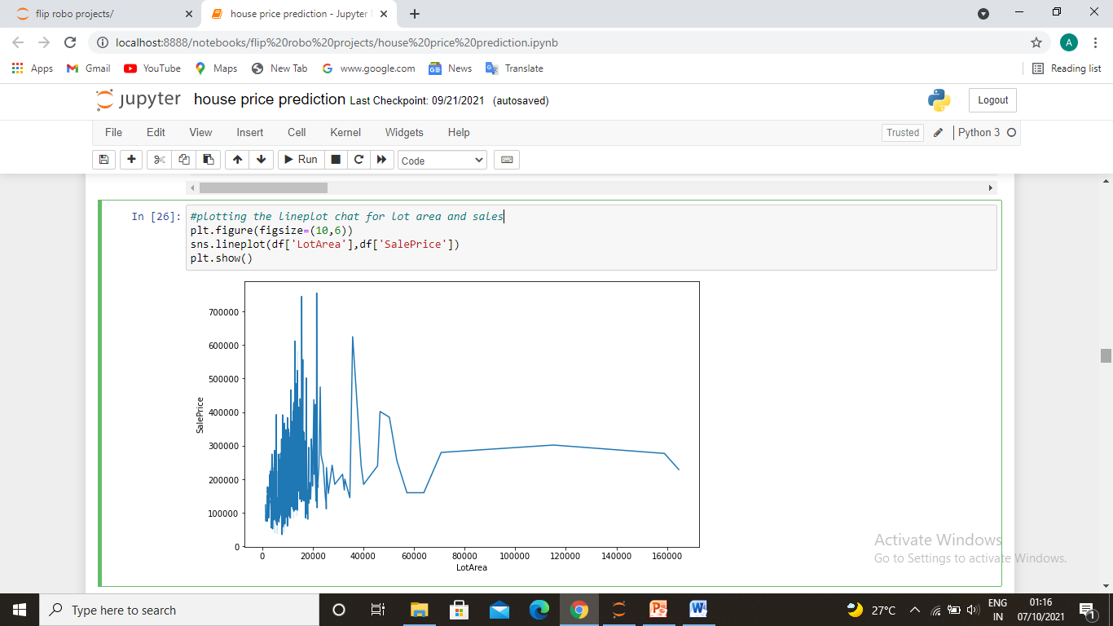
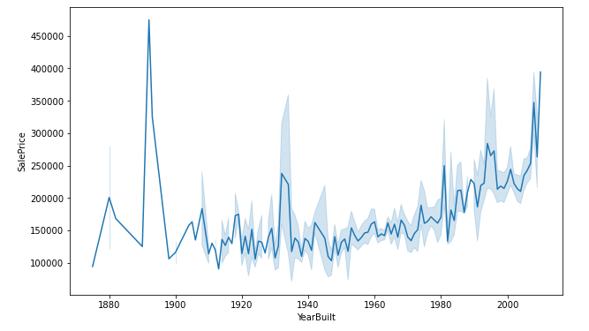
Data visualization
Visualization includes the relationships or independent variables with the targeted variable.
First diagram is the lineplot chat for lot area and sales
Second diagram is the relationship between saleprice and year of house was built.
Observation of first - property area under 20000 sq.ft. are more in the town and maximum plotting price lies under 6000 too 40000.
Observation of second - newly built house prices are higher than old house which are made before 1980's. only some very old unique houses prices are high maybe they builted with unique style

Slide 8
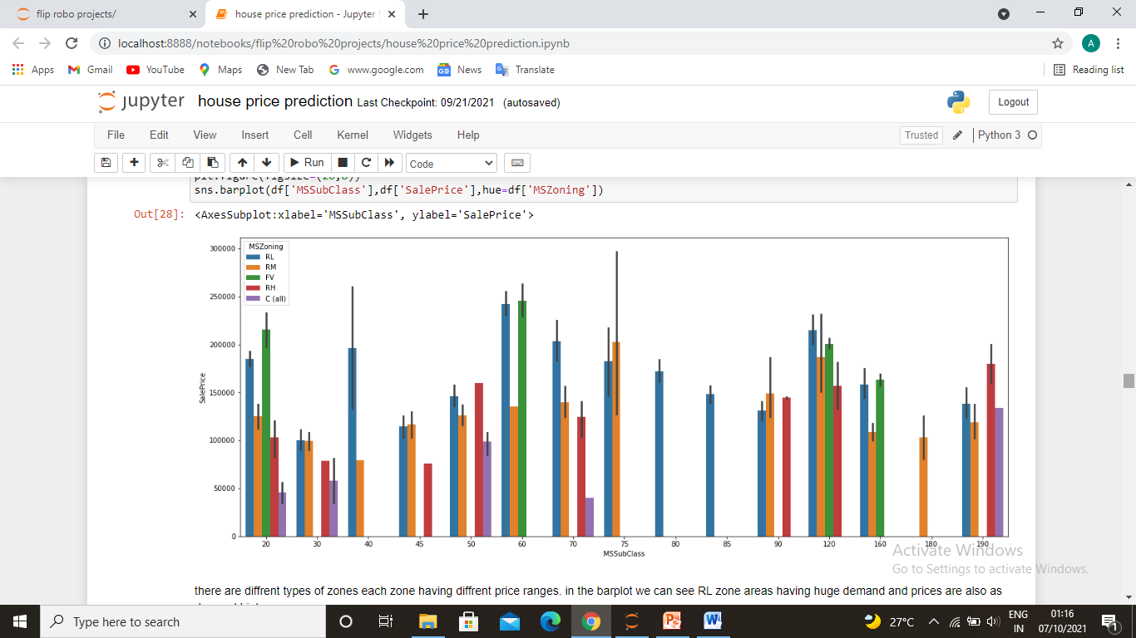
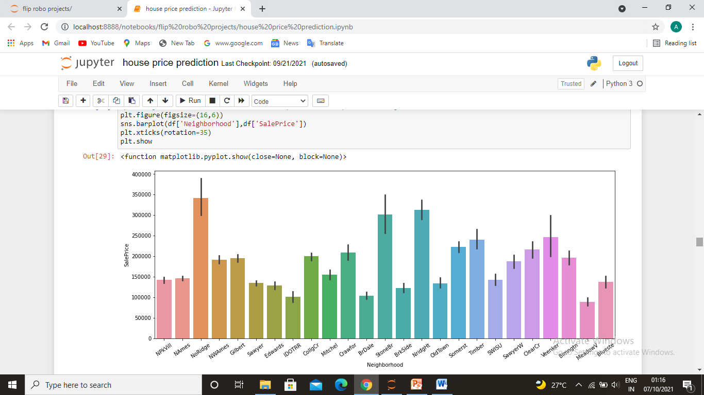
Third diagram is the relationship between saleprice and sub class of the house and zone.
Fourth diagram is the relationship between saleprice and neighborhood.
Observation of first - there are diffrent types of zones each zone having diffrent price ranges. in the barplot we can see RL zone areas having huge demand and prices are also as demand high.
dwellings in houses are have average demand and sales
Observation of second- noRidge,stoneBR and NridgeHT is kind of porsh area of something thire is price of houses are very high

Slide 9
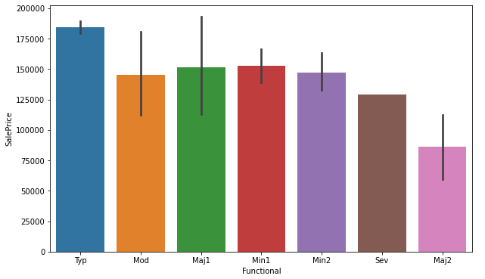
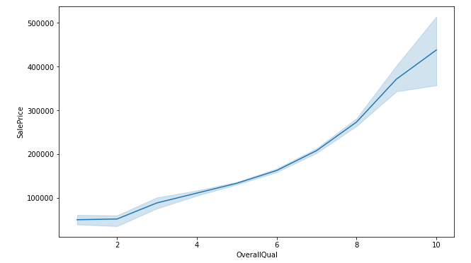
Fifth diagram is the relationship between saleprice and functional area of house.
Sixth diagram is the relationship between saleprice and overall quality of the house.
Observation of first - houses with typ function having high price as compare to other functions. and mod,maj1,min1 and min2 having average price between 125000 to 150000 so this unctions are most considerable.
Observation of second- overall quality increases with sales price with property.
overallquality between 4 to 8 are having good market

Slide 10
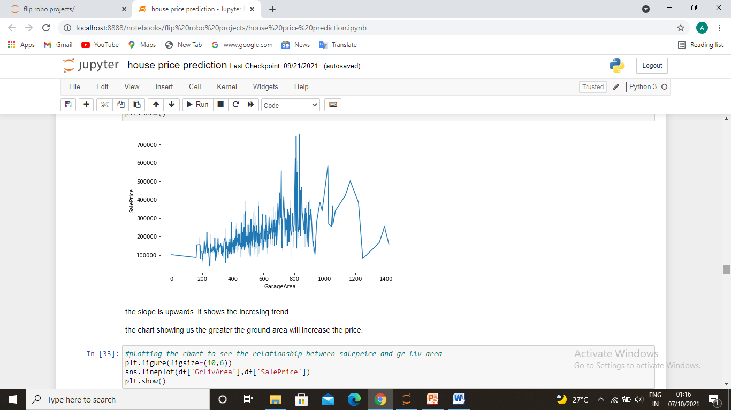
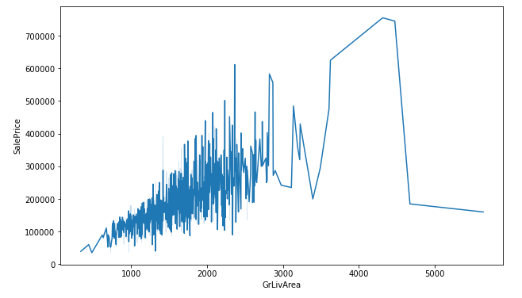
seventh diagram is the relationship between saleprice and garage area how it impact
Eighth diagram is the relationship between saleprice and gr liv area.
Observation of first - the slope is upwards. it shows the incresing trend.
the chart showing us the greater the ground area will increase the price.
Observation of second- there is much fluctuation in the data but thee trend is upwards shifting
the bars shows the greater the ground living area will higher the price.

Slide 11
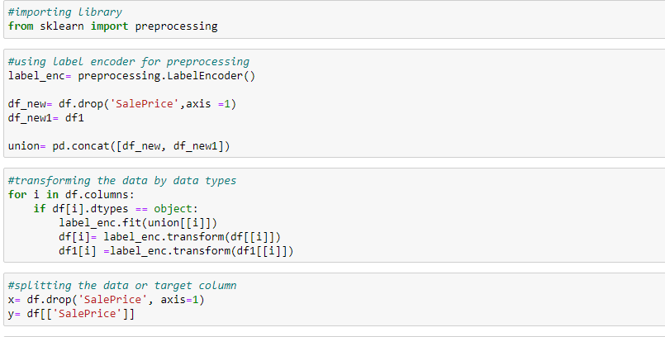
Data scaling and preprocessing
First of all we got 2 data frames test and train data we need to clean up both so first we need to clean the train data in the train data there are 1168 rows and 81 columns inclusive of nan values. So we decide to split the string and numeric columns than fill them all with different mean and mode technique. To clean the data. Than we correlate the targeted variable with some important independent variables.

Slide 12
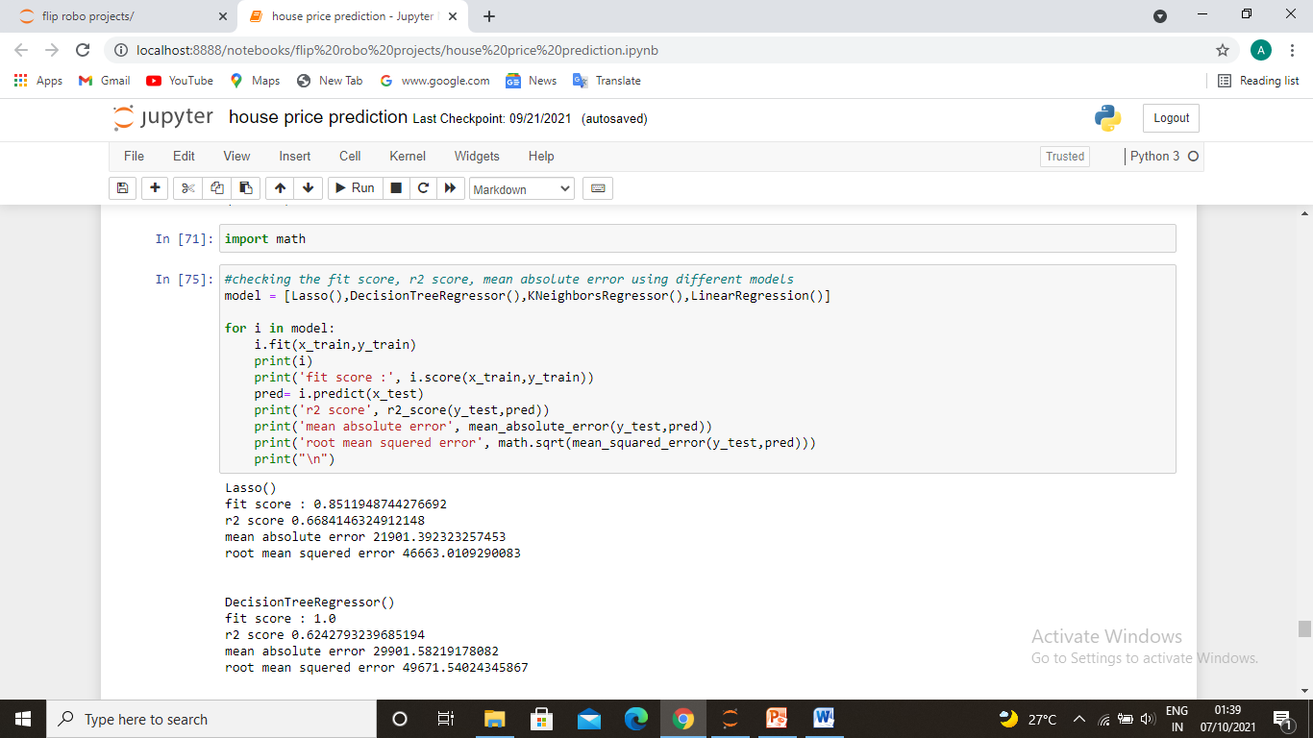
Train the model
It was a regression problem that’s why we have used linear regression. We have used random forest regressor because it gives as the best r2 score and its cross validation score was also good. And the difference between accuracy and cross validation score is very less. So we took this and also done the hyper parameter tunning to tune the data.

Slide 13
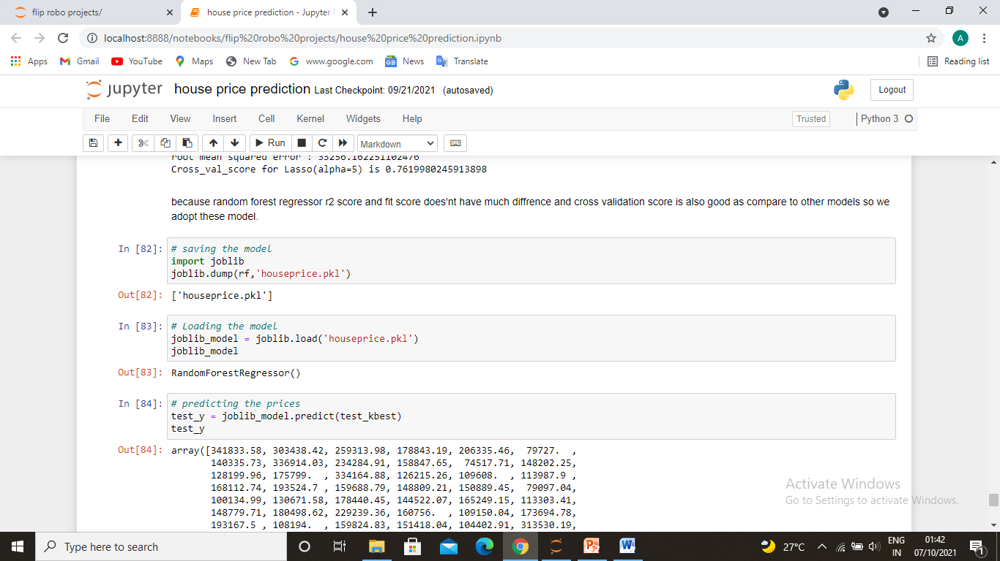
Saving the model and predicting the prices of houses with saved model and conclusion.
The conclusion is many factor as I mentioned earlier could effect the prices of the property. The newly built houses have more demand and there prices are also little high. Parking capacity also impacts the price if the garage area is large the price will increase.

